Slide 1
Community of Practice Architecture
Agenda
10:00 - 10:05 Introduction – Bennett Frazier
10:05 - 10:10 Review Strategies and Tactics
10:10 – 10:25 Microservices with Spring Boot – Raheem Jiwani, James Prabhu
10:25 – 10:55 Discussion Q&A
10:55 – 11:00 Wrap up

Slide 2
Six Strategic Pillars
Enable Game-changing Customer and Dealer Experience
Accelerate Cloud Adoption
Unlock the Power of TFS Data
Raise Security and Identity to Towering Heights
Invest creativity and innovation in customer and dealer experience to build for market differentiation, using a common, definitive cloud-based platform.
Invest for the long term in the BTS organization and process capabilities for Information Management:
Lead the TFS Digital Transformation with Microservices and APIs
Application architecture and deployment will target a service oriented microservice architecture pattern in preference to a monolithic architecture.
Cloud first strategy expressed by four principles:
Empower Mobility for People Processes & Work
Communication and collaboration for teams and process is a top priority for BTS. Enable mobile tools to be used for fulfilling business functions as easily as (or more easily than) office tools.
Reduce the number of Standards
SaaS > PaaS > IaaS > Legacy
Reuse > Buy > Build
Minimize point solutions
Shrink the footprint of technologies requiring upgrades as fast as possible by shifting funds from uplift toward new cloud solutions.
Standardize on Cloud platforms rather than implementing best-of-breed solutions with a lot of external integration.
Use Commercial off the Shelf (COTS) on IaaS (and if necessary, on premise) only after cloud options are exhausted.
Leverage open source standards for middleware and database.
Channel and campaign technologies for phone, text, email, mobile, web, social and video will be standardized.
Touchpoints will be instrumented to collect behavioral metrics. Data, machine learning, and artificial intelligence will enable Kaizen of the touchpoints.
New, successful technologies will be standardized for the benefit of all.
Ensure that technologies and techniques provide a malleable data model to support adaptability to new, unforeseen business capabilities.
Business information glossary and end-to-end Process lineage for intelligent impact analysis
PII and security attributes mapped to systems (information classification)
Proactive identification of data quality issues and defined Data Quality key performance indicators (KPI) for BTS
Data lifecycle, retention requirements
Target a converged, cloud-based platform for Master Data Management (MDM), capable of supporting hierarchies and integration. MDM will target “Transactional” use but will also offer Consolidation, Reference and Coexistence options as bridges to the future state.
Transactional use > Reference, Coexistence, or Consolidation [though coexistence could be relevant when performance needs cannot be met by transactional model]
Application communication will evolve from the current central code-embedded hub model toward distributed integration through exposed services and Application Programing Interfaces (APIs).
Each API will be owned by the service team that manages the system or service providing the API -- in order to improve agility, accuracy, and reduce the number of teams and systems impacted by change.
Business logic related to a service will be the responsibility of the service team managing the system of record (SOR) (or developed microservice).
Any custom microservice will be developed on a standard PaaS platform. Microservice architectures will be highly cohesive “subject based” web services that support bounded context based on function, data, and business process.
Loosely coupled, Stateless
Separately deployable
Dev will support agile methods for continuous integration
BTS will maintain a service registry
APIs become “official” only when “registered” in the service registry
Any TFS service shall be either registered or deprecated. (No rogue or unmanaged services.)
Helpful documentation about API services will be kept in a central location.
All TFS API and service access will utilize the same security platform.
Event-based integrations will be introduced to support future of mobility, internet of things (IoT), analytics, and data warehousing. BTS will target PaaS-offered event streams and packages to perform composition and aggregation, complex data mapping, and ingestion of event streams to populate the local data stores of developed microservices.
Enterprise application integration (EAI) tools will target PaaS on a converged cloud platform.
Converge on-premise security tools for identity and access management into a common cloud platform with broad capabilities
Multifactor authentication, SSO Portal, SAML / OAuth support, directory integration, mobile access support, and API protection
Integrated provisioning and DE-provisioning with out-of-the-box support for SaaS, PaaS, and IaaS
Monitor or block data leaving TFS-engaged resources, cloud and on-prem. Evolve data loss prevention (DLP) toolkits into a single, fully capable Cloud Security Gateway (CSG) with rich policy enforcement capabilities including encryption at-rest and in-transit for sensitive data.
Preserve confidentiality of non-public data, both within the walls of TFS and across cloud environments, from unauthorized view or use, by appropriately applying encryption and data masking technologies for data:
At rest
In memory
In transit
Address configuration compliance and configuration drift. Continue to grow security monitoring as a 24/7 service with standardized tools for Threat Management across cloud platforms and on premise, including but not limited to Patch Monitoring, Log and Event Management, External / Internal Vulnerability Scans, File Integrity Monitoring, Malware Protection, and Application Development Security Assurance.
Invest in TFS network capabilities to provide the fastest most reliable service possible.
Introduce a “user centric computing” team to study and understand the needs of technology users.
Enable workers to “Bring your own device.”
Provide special needs access to support the future of mobility.
Ensure that all TFS business function-supporting technology, whether internally managed or obtained via third party, has process and system recovery capabilities that satisfy TFS Business Continuity Management (BCM) standards.

Slide 3
Microservices Initiative @EIP/EPS
Use Case:
Enterprise Pricing Service needs to source the pricing and incentive data to multiple clients such as DFP, MST, Payment Calculator and Other Retail apps (mobile and web) through UIS (universal incentive Service) gateway. EIP/EPS need to scale to serve pricing data in Sub second response time with throughput in the range of 200 – 400 TPS.
Solution:
To adopt MicroService architecture and build the applications with cloud native technology to be able to scale on prem initially followed by lift and shift to the cloud to scale for even higher throughput.
Application design to produce self contained artifacts (preferably containerized) to deploy on the cloud platform that is approved by TFS (Azure, AWS, PCF or any other).

Slide 4
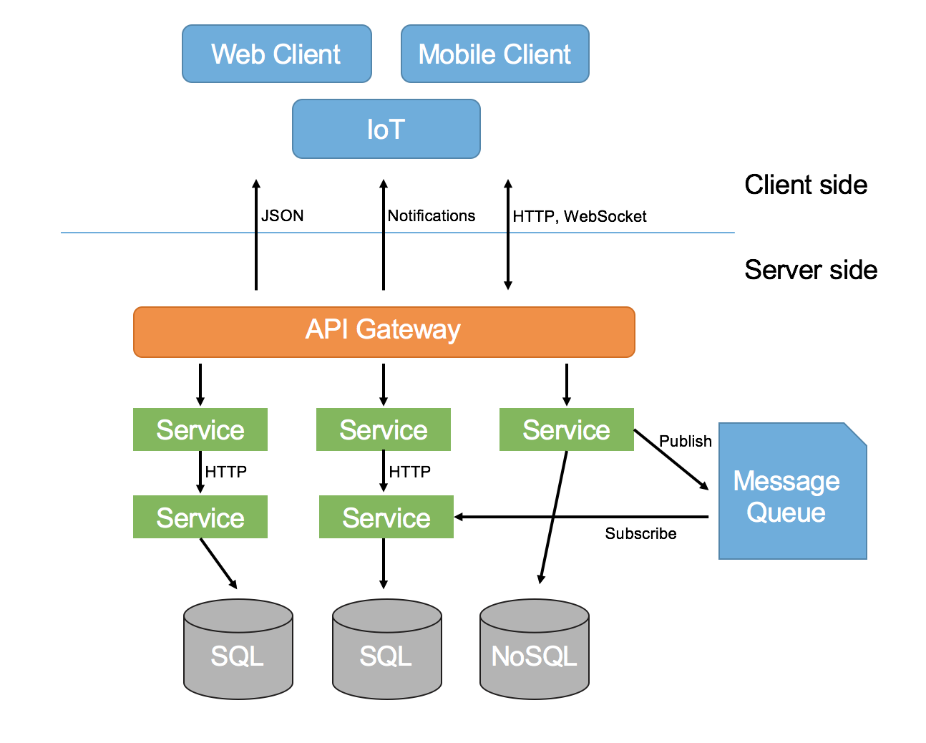
Microservices Architecture

Slide 5
Microservices Benefits
Smaller code base is easy to maintain.
Easy to scale as individual component.
Technology diversity i.e. we can mix libraries, databases, frameworks etc.
Fault isolation i.e. a process failure should not bring whole system down.
Better support for smaller and parallel team.
Independent deployment
Deployment time reduce

Slide 6
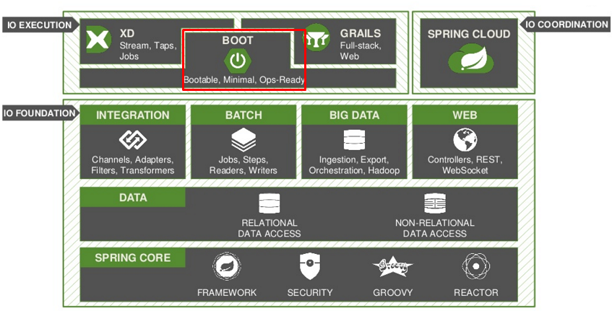
Spring Boot Framework

Slide 7
Spring Boot Goals:
To provide a radically faster and widely accessible getting started experience.
To be opinionated out of the box, but get out of the way quickly as requirements start to diverge from the defaults
To provide a range of non-functional features that are common to large classes of projects (e.g. embedded servers, security, metrics, health checks, externalized configuration)
Spring Boot does not generate code and there is absolutely no requirement for XML configuration.

Slide 8
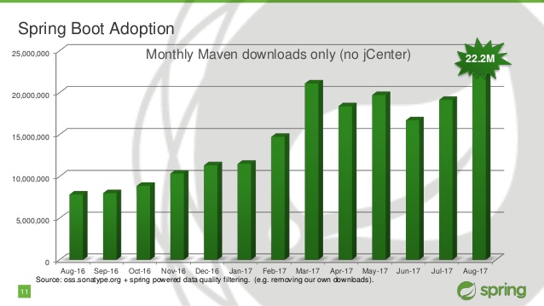
Spring Boot Adoption:

Slide 9
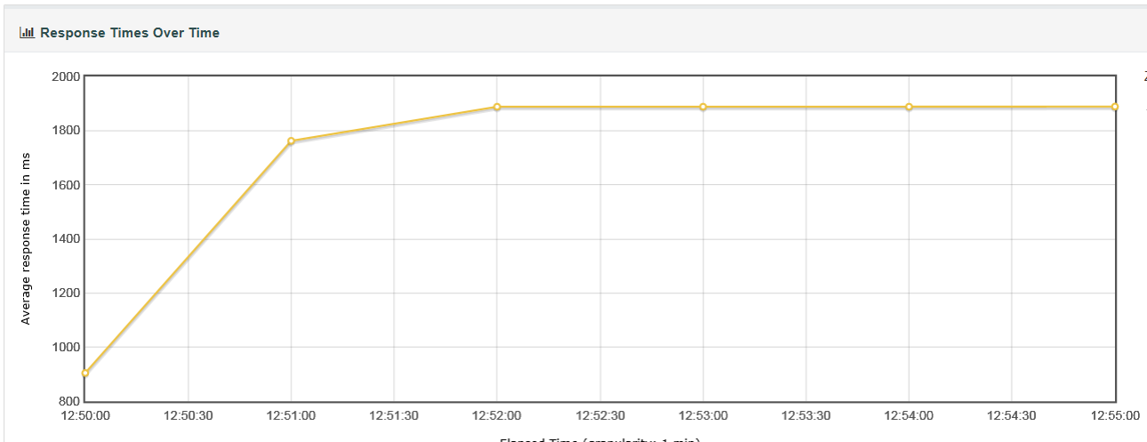
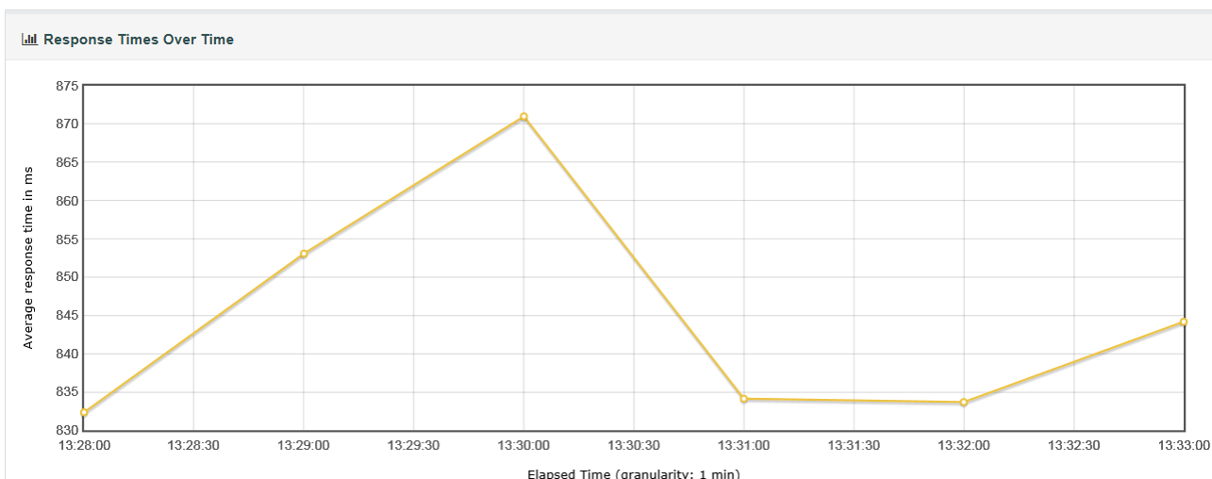
Performance Comparison:
Integration Component : 50 Users Test
MicroService: 50 Users Test

Slide 10
Current Architecture
Today
System Deficiencies:
Fragmented Infrastructure
Slow end to end response times
Major dependency on Vendor Partners for Data
Dependency on Vendor Partners for functionality
Vendors / partners instability (Chrome, RouteOne)
Limited supportability by TFS
Lack of visibility to resolve day to day issues
Data Availability Gaps
3rd Party Integration:
Lack of seamless 3rd party integrations
Vendors want TFS data but not payment calculator
Have own methods for attaining TFS data (manually)
Results in inconsistent experience

Slide 11
Future Architecture – EPS Integration
Phase I
System Improvements/ Advantages:
Single Source of Data
Remove dependency on Vendor for Data
More control for enhancements with TFS
Increased supportability by TFS
Improved Performance & Stability
Instant Data availability
Pros:
Centralized Data
Centralized architecture
Increased TFS ownership
Ease of supportability
Decreased Vendor reliance
3rd party integration
Re-usability
Cons:
Tech effort with TFS
Substantial initial investment cost
(financial & in technology)

Slide 12
Future Architecture – TFS Residuals Integration
Phase II
System Improvements/ Advantages:
Phase I plus…
Enhanced Functionality capabilities
Business Rules Engine
TFS residual now integrated with TFS PE
D&D micro-service part of PE
Reduction in Communication channels
3rd Party Integration:
3rd party Integration via API Service
Single Source of Data for constancy
Reuse Data cached in EIP/EPS
Vendors can utilize their functionality ( PE)
Available both Batch/bulk & transactional

Slide 13
References:
https://projects.spring.io/spring-boot/
https://spring.io/docs
http://microservices.io/patterns/microservices.html

